Slide 1

Find a Roomie
Welcome స్నేహితులు, दोस्त, Friends, நண்பர்கள், ಸ್ನೇಹಿತರು, Amigos
Connecting Students Globally for Accommodation
Team Maverick Team 35
Abhinav Chary Eeranti
Abhishek Chintapalli
Tirdesh Pettugani
Sai Krishna Kotla

Slide 2
Introduction
"Roomie" is a web application designed to assist people especially students across the globe in finding suitable accommodation. With a focus on ease of use and security, it offers a platform for users to list or search for rooms with just a few clicks.
Features
User Registration/Login
Landing Page
Room Listings
Post a Room
Room Finder
Wishlist
Map Integration
Chat System
Blog

Slide 3

How to find a Room?
Checklist Creation: Specify location, budget, gender preference, amenities, etc.
Search Filters: Refined search capabilities.
Communication: Facilitates initial contact between users.
Contact Exchange and Moving In: Coordinate finalizing the deal and moving in.
How to rent a Room?
Comprehensive form to capture property details, type, accommodation duration, security deposit, availability date, expectations, and amenities

Slide 4






Key Highlights
Easy chat options for the user
Blogs for better interaction
Advance search features: Filtering, Maps and different views
Single Page for posting a Room and Finding a room
Wishlist

Slide 5











Tools used:

Slide 6
Milestones
Creating an Object Model using Domain Driven Design
Drafting the user stories and finding the corresponding API
Testing the API connections
Creating the prototypes using Figma
Creating the basic DOM structure and Landing Page
Implementing basic components and user on boarding
Integrating the with back end
Creating the CRUD operations
Implementing the complex features and other functionalities
User Testing and validation

Slide 7


Slide 8
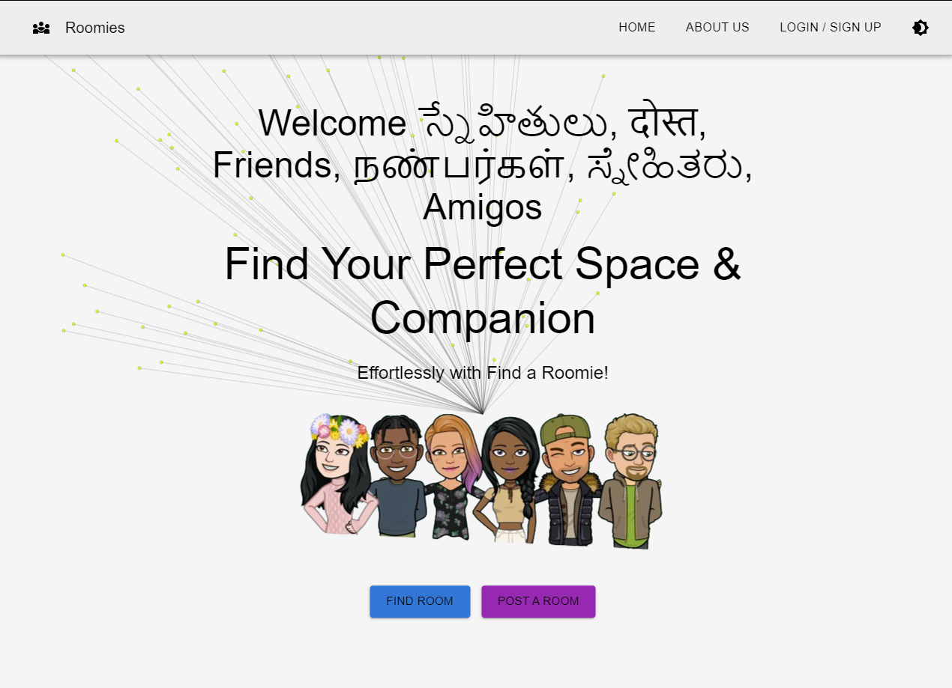
Landing Page
Before login

Slide 9
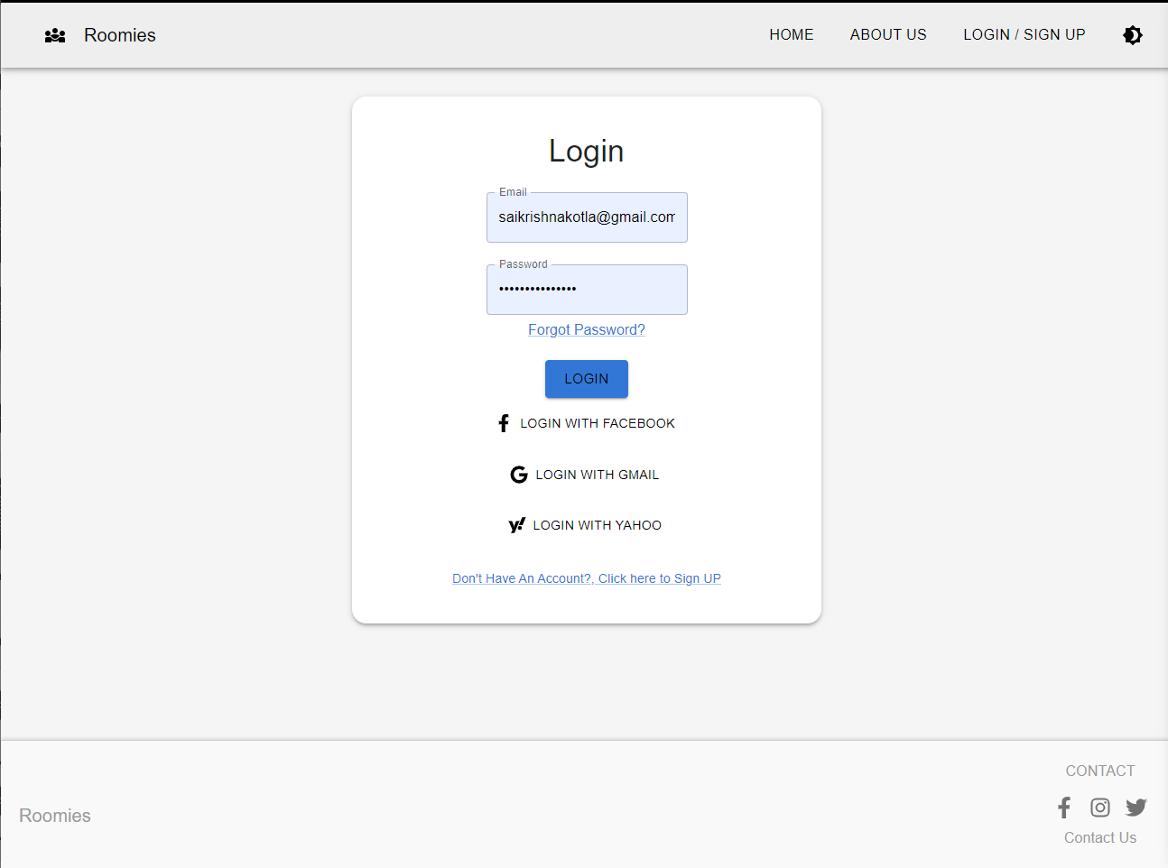
Login

Slide 10
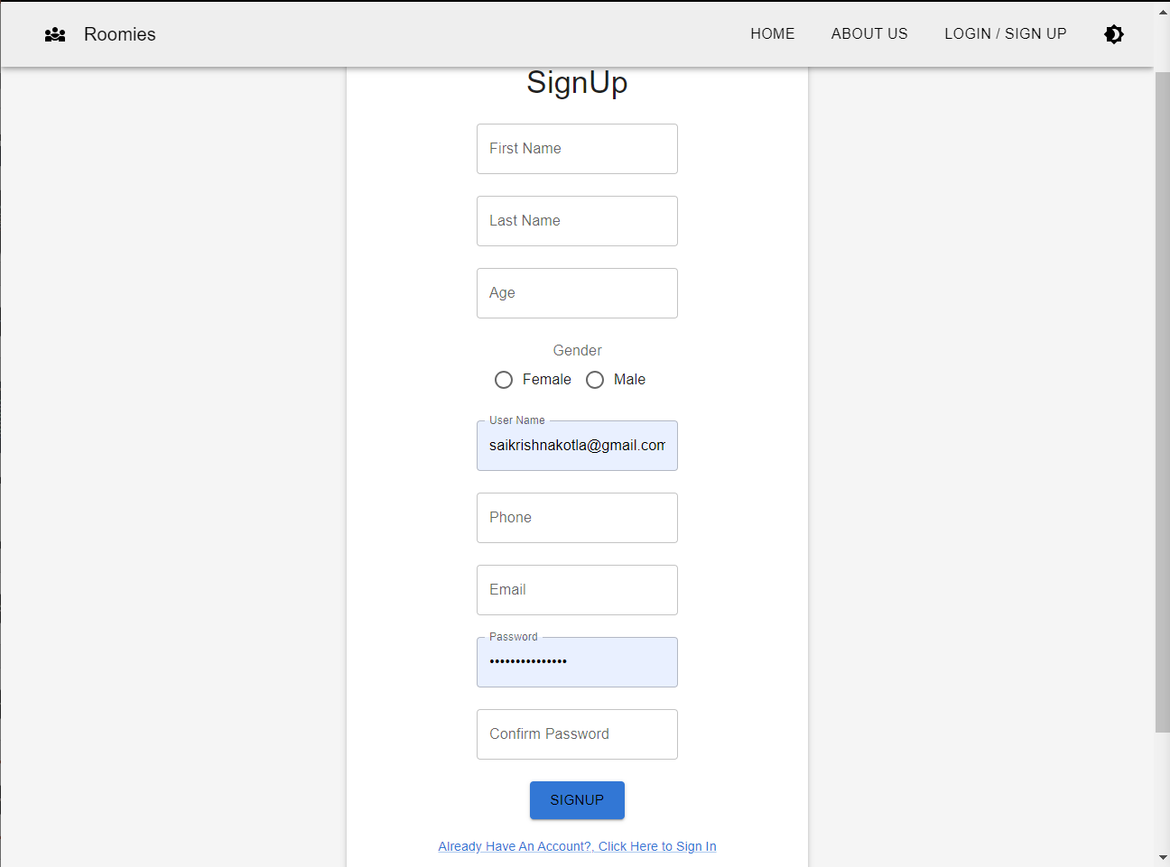
Sign Up

Slide 11
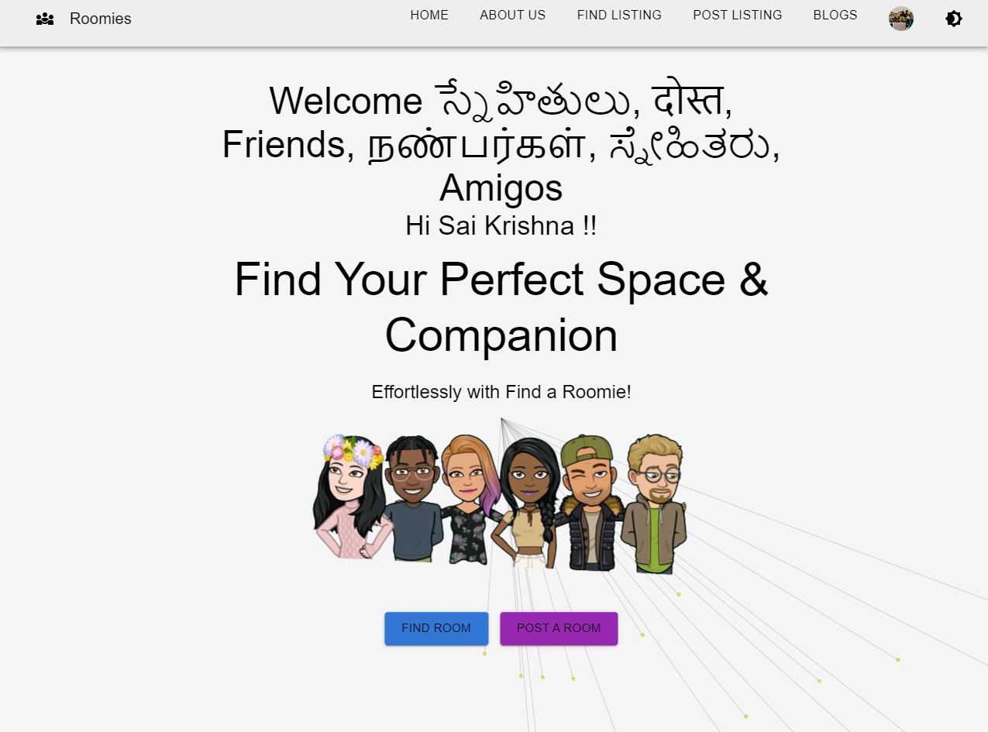
Landing Page after Login

Slide 12
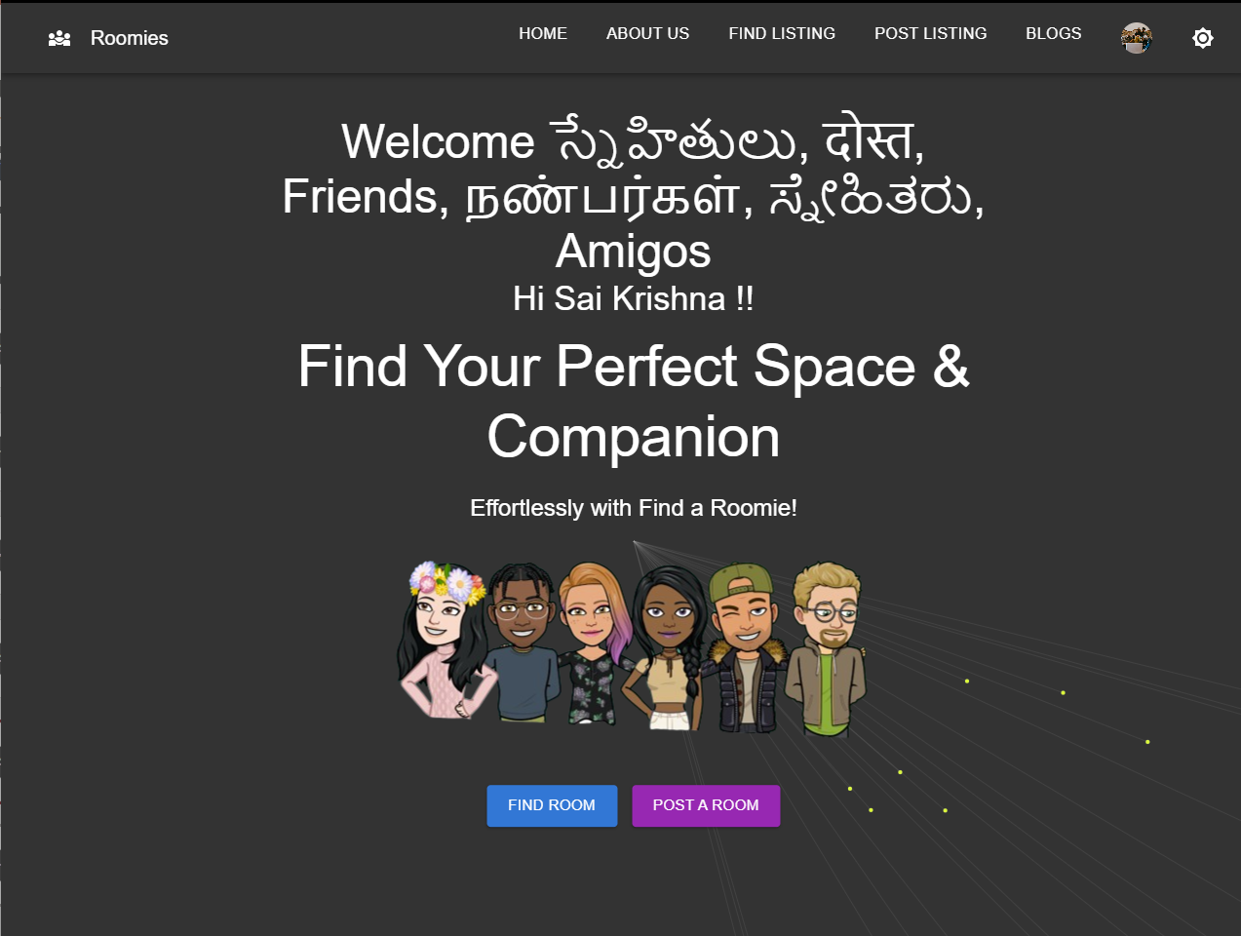
Theme Toggle

Slide 13
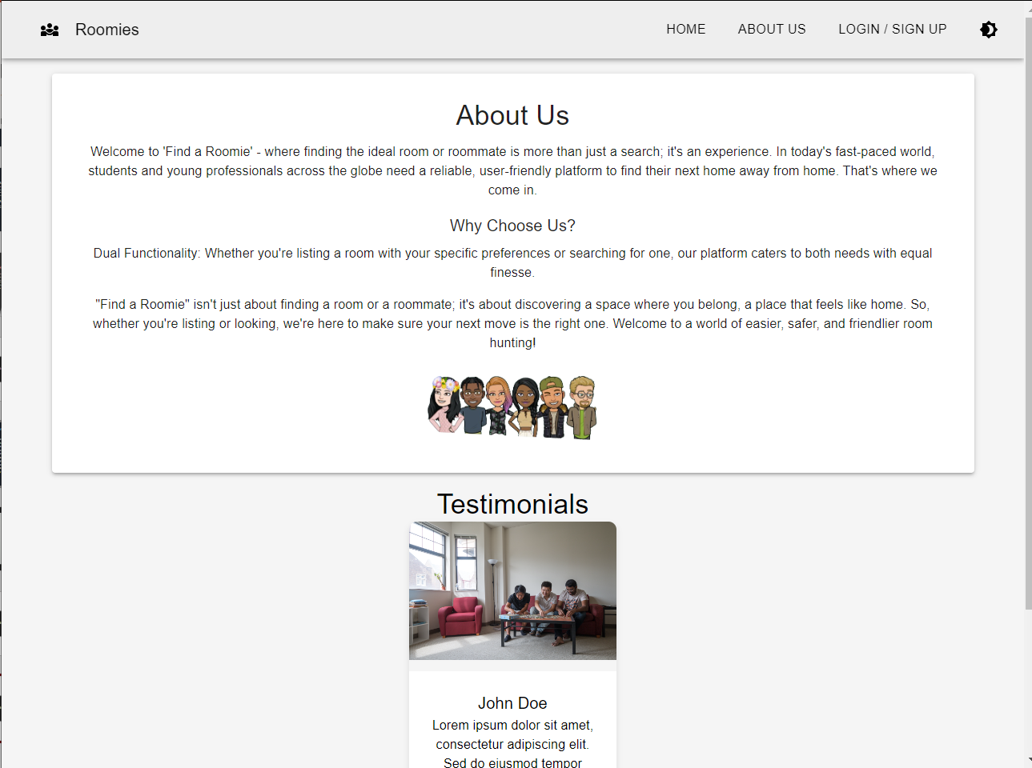
About Us

Slide 14
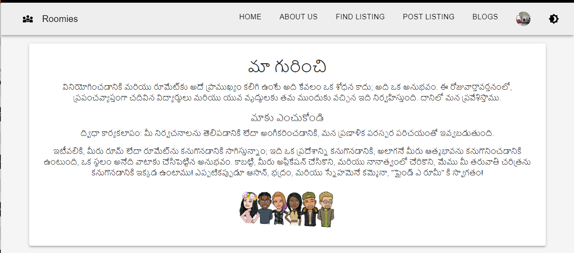
Internationalization

Slide 15
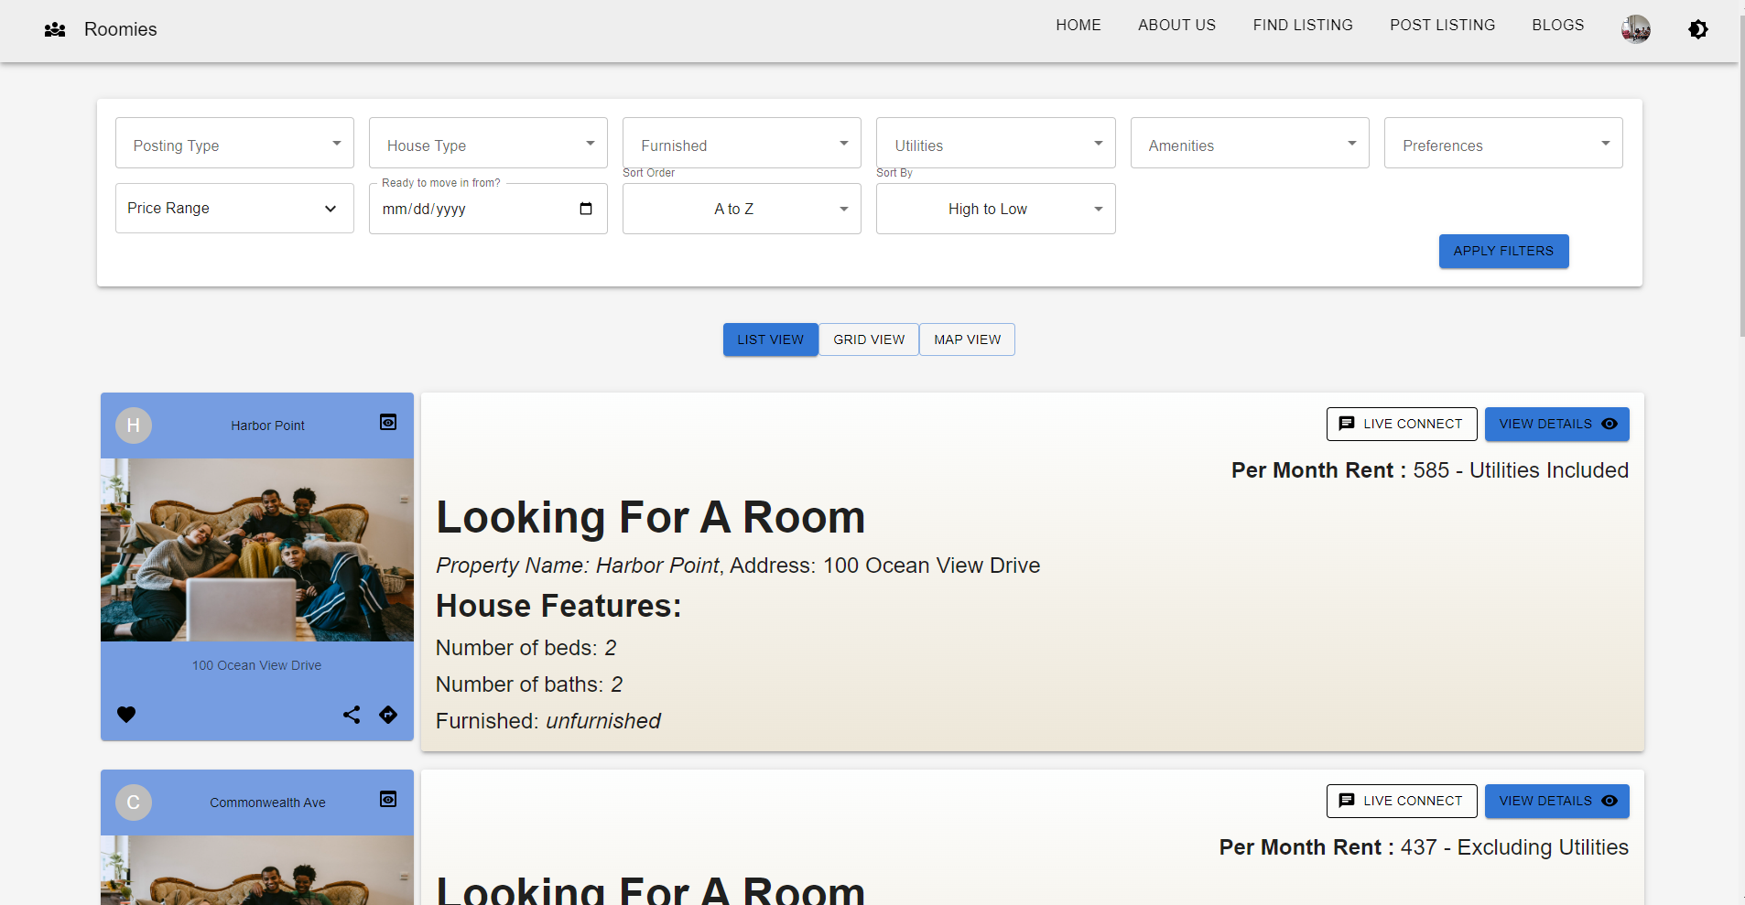
Find Listing

Slide 16
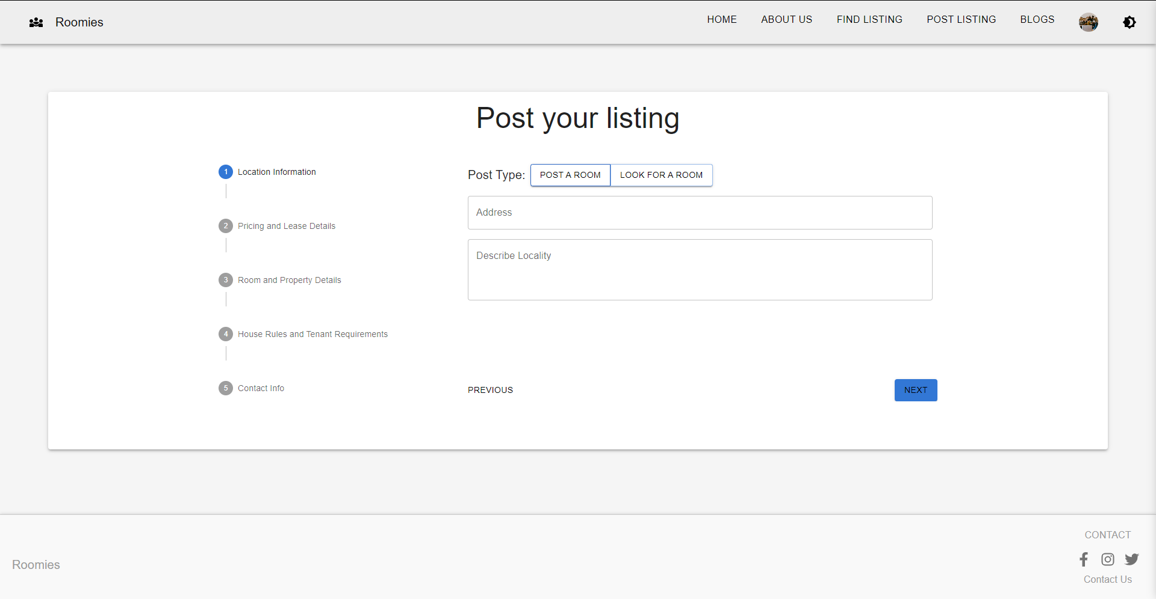
Post Listing

Slide 17
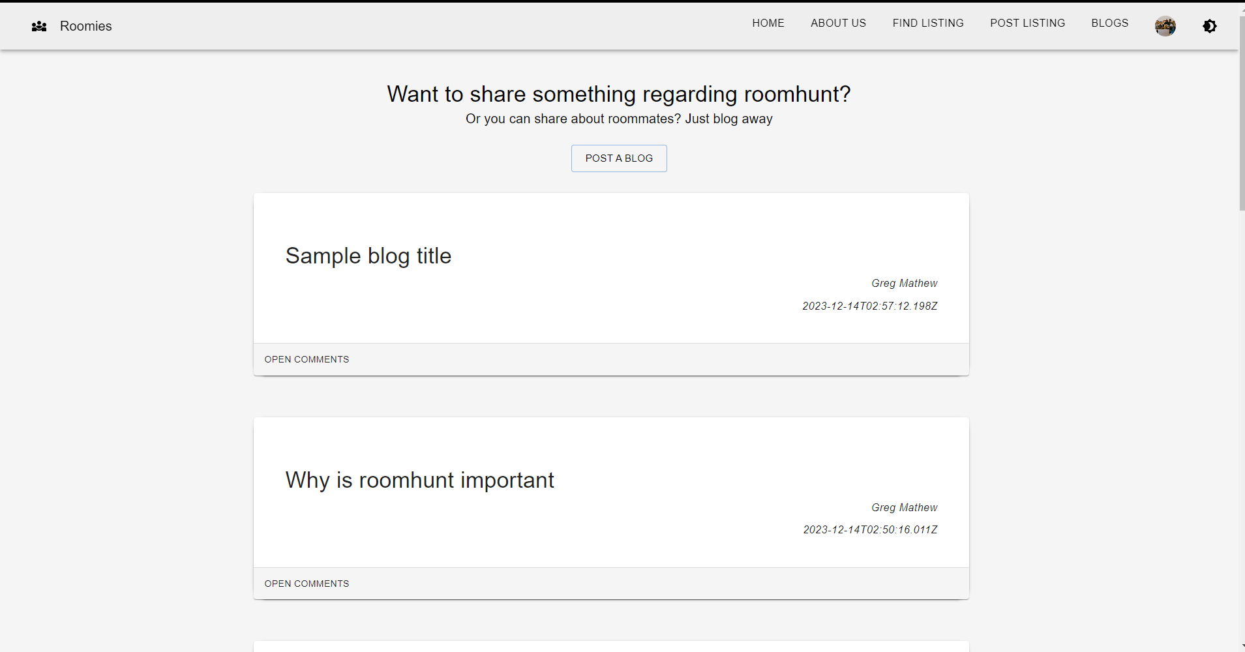
Blog Listing

Slide 18
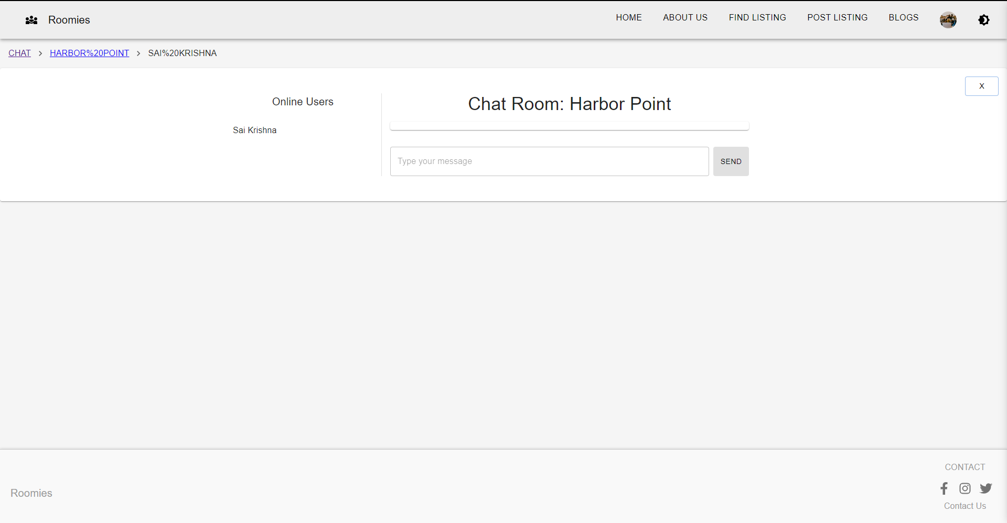
Chat Room

Slide 19
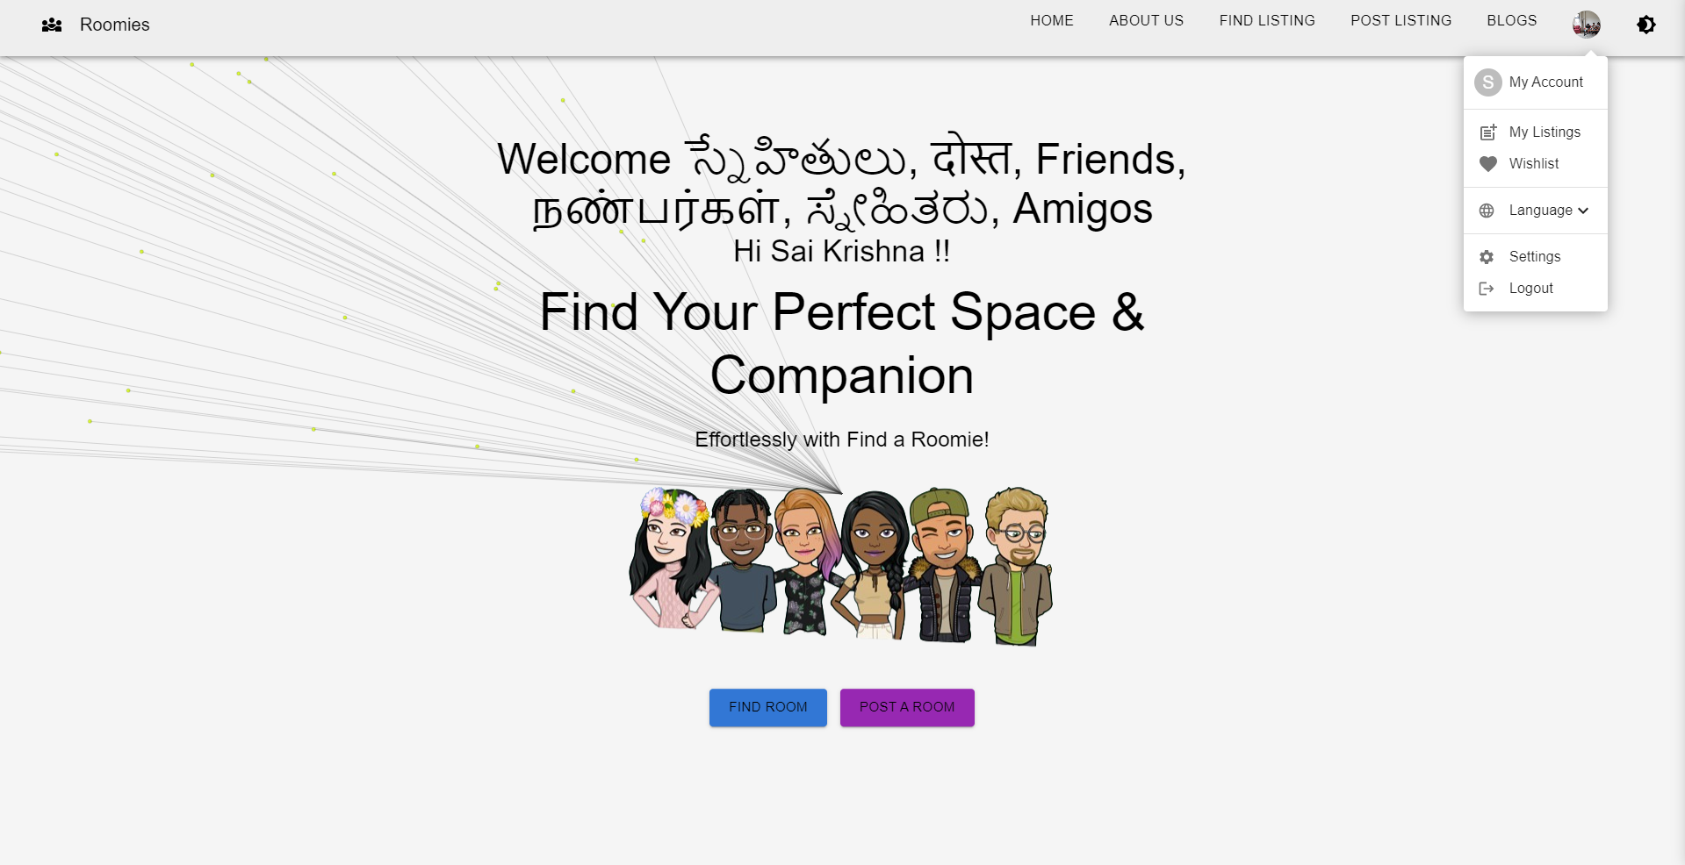
Menu

Slide 20
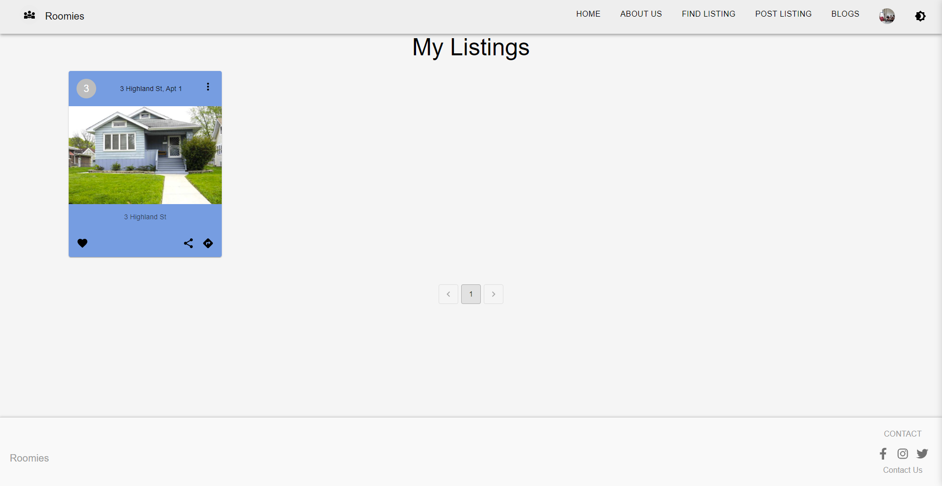
My Listing

Slide 21
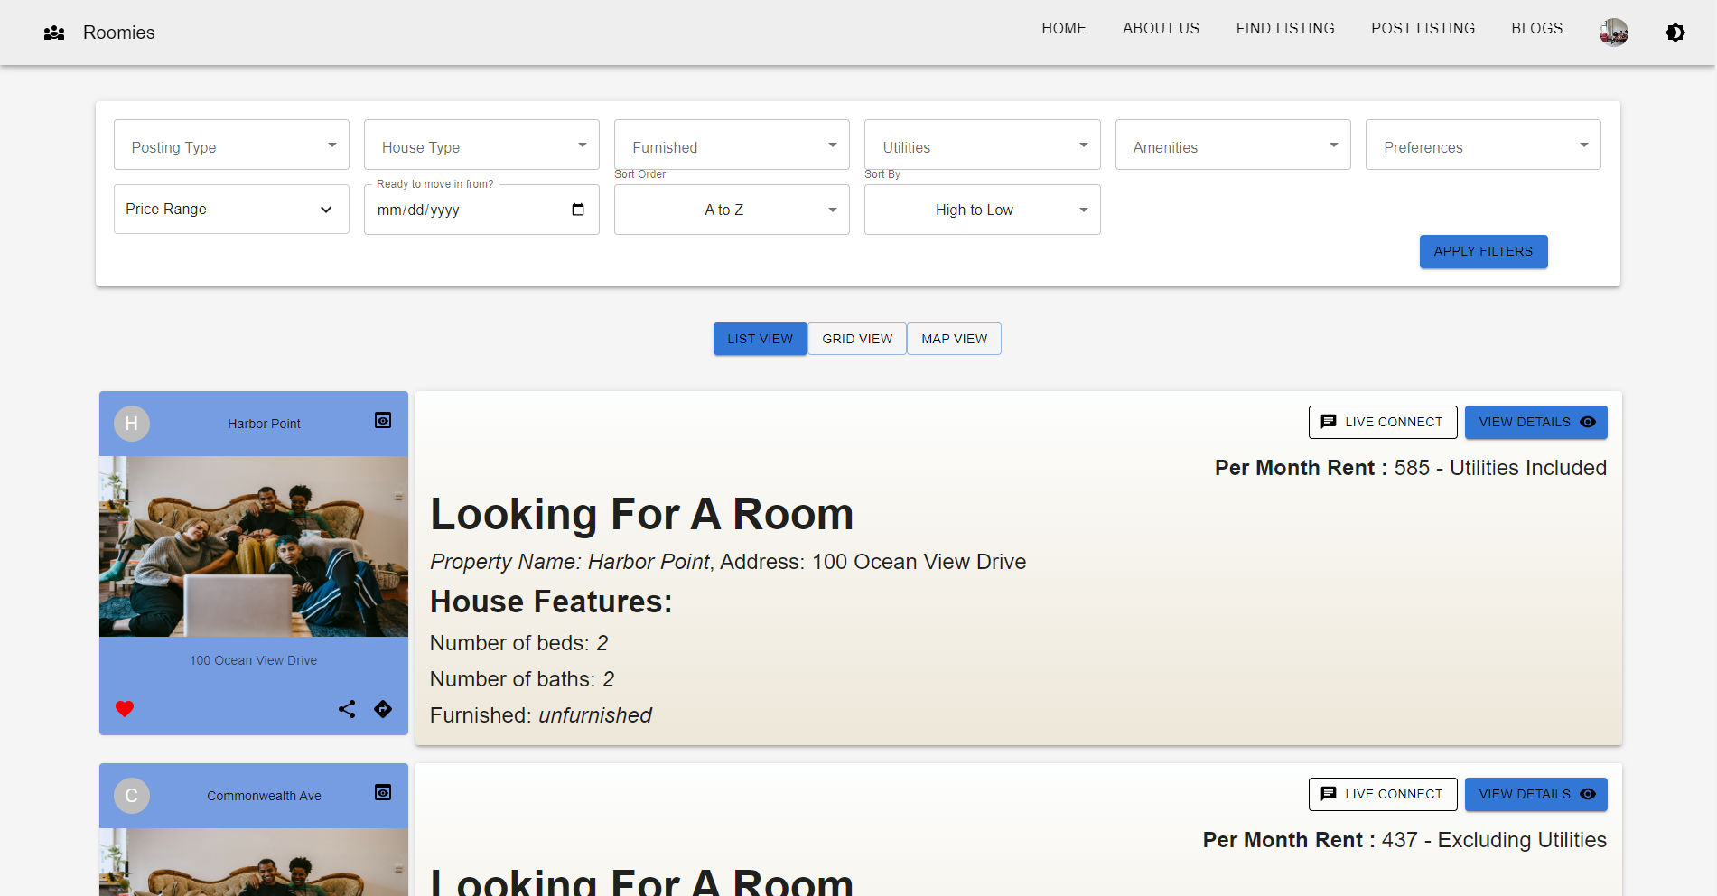
Wishlist

